Slide 2
Objectives (htdp.org 3.6 Designing World Programs)
Knowledge:
What are the parts of a big-bang expression?
Skills:
Write a simple big-bang expression to create an animation.

Slide 3
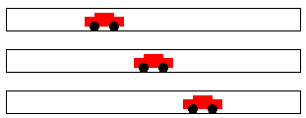
Define world constants

Slide 4
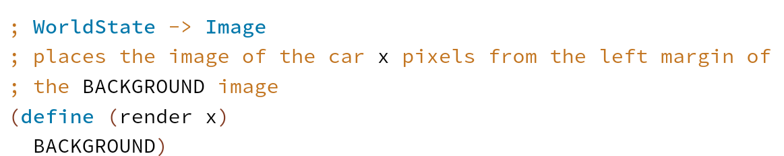
Render the world state as image

Slide 5
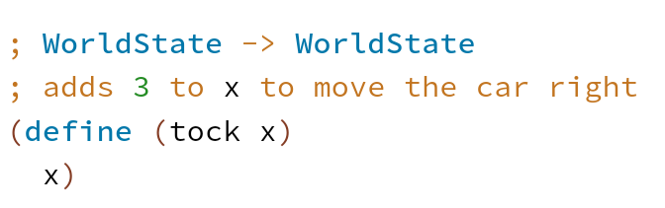
Update the world state to the next state

Slide 6
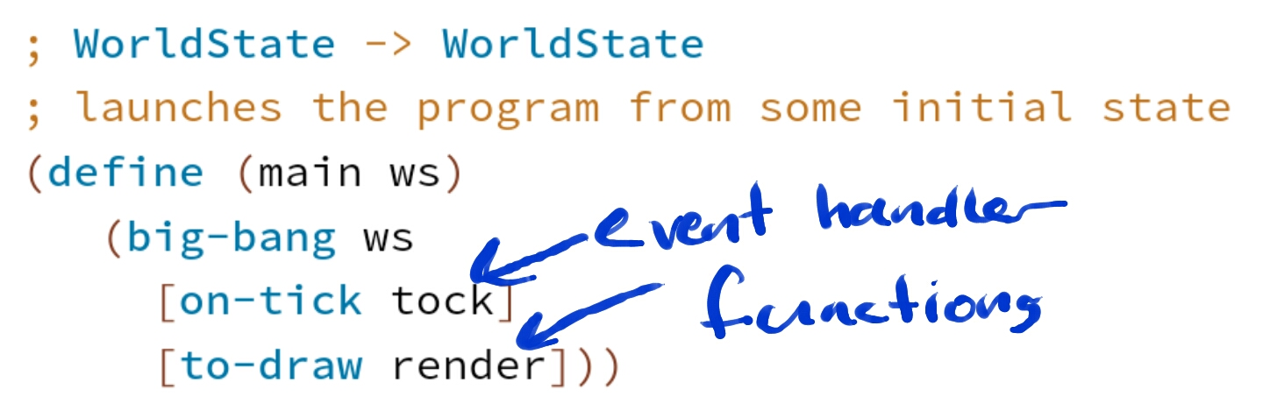
The main function launches the program

Slide 7
Warm Up
Design a car image that will be used in our animation.

Slide 8
Today’s Challenge
Design a program that moves a car across the world canvas, from left to right, at the rate of three pixels per clock tick.

